Slide 1
Project Title:
RFID Based Attendance System with
Database Integration
Presented By
Kandula Venkat Sai
Reg.No: V23HE10K15

Slide 2
CONTENTS
Overview
Block Diagram
Components
What is RFID?
Process Flow
Database Integration
Advantages & Applications
Conclusion

Slide 3
OVERVIEW
Problem Statement:
Manual attendance systems are time-consuming and prone to errors.
Need for automation and real-time attendance tracking in institutions or workplaces.
Objective:
Implement a system to automate attendance using RFID and database for efficient tracking and management.

Slide 4
COMPONENTS
Hardware:
LPC2148 Microcontroller
RFID Reader & Tags
LCD Display
4x4 Keypad Matrix
AT89C512 EEPROM
Database Integration (PC)
Software:
Keil IDE & Embedded C
Database(MS-Excel/Liber Office)

Slide 5
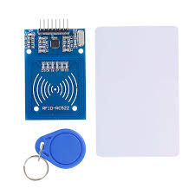
What Is RFID?
RFID (Radio Frequency Identification) is a wireless technology used for automatic identification and data capture. It consists of two main components: an RFID tag, which contains a unique ID, and an RFID reader, which communicates with the tag via radio waves.
RFID Reader and Tags

Slide 6
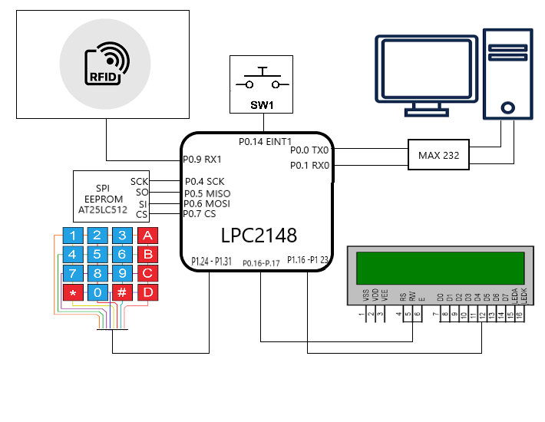

PROCESS FLOW

Slide 7
DATABASE INTEGRATION
Each and every scan of the reader which is collected through microcontroller is read and packed with the current time and this packed data is transmitted to PC using UART protocol.
Program Running in the PC will read the received data in serial buffer and updates the data in excel sheet with In/Out depending on the status.
The maximum In time count of the day is 3 exceeding this the entry will not be considered in the total working hours.

Slide 8
.
ADVANTAGES
&
APPLICATIONS
Advantages:
Fast and accurate attendance marking.
Eliminates manual errors and reduces processing time.
Easily scalable to large institutions.
Applications:
Educational institutions, offices and travel

Slide 9
.
CONCLUSION
The RFID-based attendance system using LPC2148 offers an efficient, automated solution for real-time attendance tracking.
It eliminates manual errors, speeds up the process, and ensures accurate record-keeping.

Slide 10


